Slide 1

Spam review detection using linguistic and behavioural methods
Batch No:18A10 G.Chandana - 18251A1210 C.Rakshitha - 18251A1235 J.Sri Harshini - 18251A1242 M.Deekshitha - 18251A1252 Guide: Ch.Sravanthi(Assistant professor)

Slide 2
Problem Statement
Consequently,manufacturers and sellers are extremely concerned with customer reviews.To gain profits or fame,spam reviews are written to promote or demote targeted products or services.
This practice is known as review spamming.

Slide 3
Objectives:
1.The main objective of our project is to predict whether the review is spam or not.
2.To display the percentage of spam content called as spam score in the form of pie chart.

Slide 4
Existing System
1.Web Spam Or Email Spam Detection.
2. MuKherjee developed a spam review detection method using a clustering technique by modelling the spamicity of the reviewer to identify spammer and non-spammer clusters.
3.Heydari have proposed a model incorporating only time series feature of the reviewer on an amazon real dataset.

Slide 5
4.Kumar have proposed a hierarchical supervised learning method.This method analyzed reviewers behavioural features and their interaction using multivariate distribution.
5.Zang recommended a supervised model based on reviewer features to identify spam reviews.
6.Ahmed and Danti used various rule based machine learning algorithms.Moreover the authors compared the effectiveness of the proposed method through a ten-fold cross-validation training model for sentiment classification.

Slide 6
The proposed approach incorporated linguistic features and a number of behavioural features for developing the spam review detection model.
Proposed models

Slide 7
SOFTWARE REQUIREMENTS SPECIFICATION
SCOPE:
The aim of this work is to develop an Spam Review Detection(SRD) model adapting a vast set of behavioral and linguistic features on large-scale real-world dataset.

Slide 8
SYSTEM ENVIRONMENT:
Spam Review Detection Model environment consists of user and Co-operating system. The user access the platform using internet. Any user can login through the system using his saved credentials otherwise by registering himself to the system.

Slide 9
Functional Requirements of User:
FR1 | The system must enable user to register themselves by providing their personal details.
FR2 | The system must allow users to login through their username and password after registering.
FR3 | The system must allow users to reset their profile.
FR4 | The system must show whether the review is spam or not
FR5 | The system must provide spam score to the user.

Slide 10
Functional Requirements of Admin:
FR6 | The System must allow Admin to access the database of the application.
FR7 | The system must provide admin all control over credentials details of users.
FR8 | The System must allow user to provide input review

Slide 11
Non-Functional Requirements for User and Admin:
NF1 | Usability
NF2 | Reliability
NF3 | Supportability
NF4 | Security

Slide 12
DataBase Description
Our dataset is of size 40,433. Data set consists of 4 attributes namely
Category, Rating, Label, Review Text.
Attribute description:
1.Category : Various types of products are categorized into the different types like Sports and outdoors,Kitchen,Books,Electronics..etc
2.Rating : It takes a numeric value ranging between 1 to 5.
3.Label : whole dataset is divided into two classes labelling CG(computer generated fake review),OR(Original Review)
4.Text : Review text in the dataset.

Slide 13
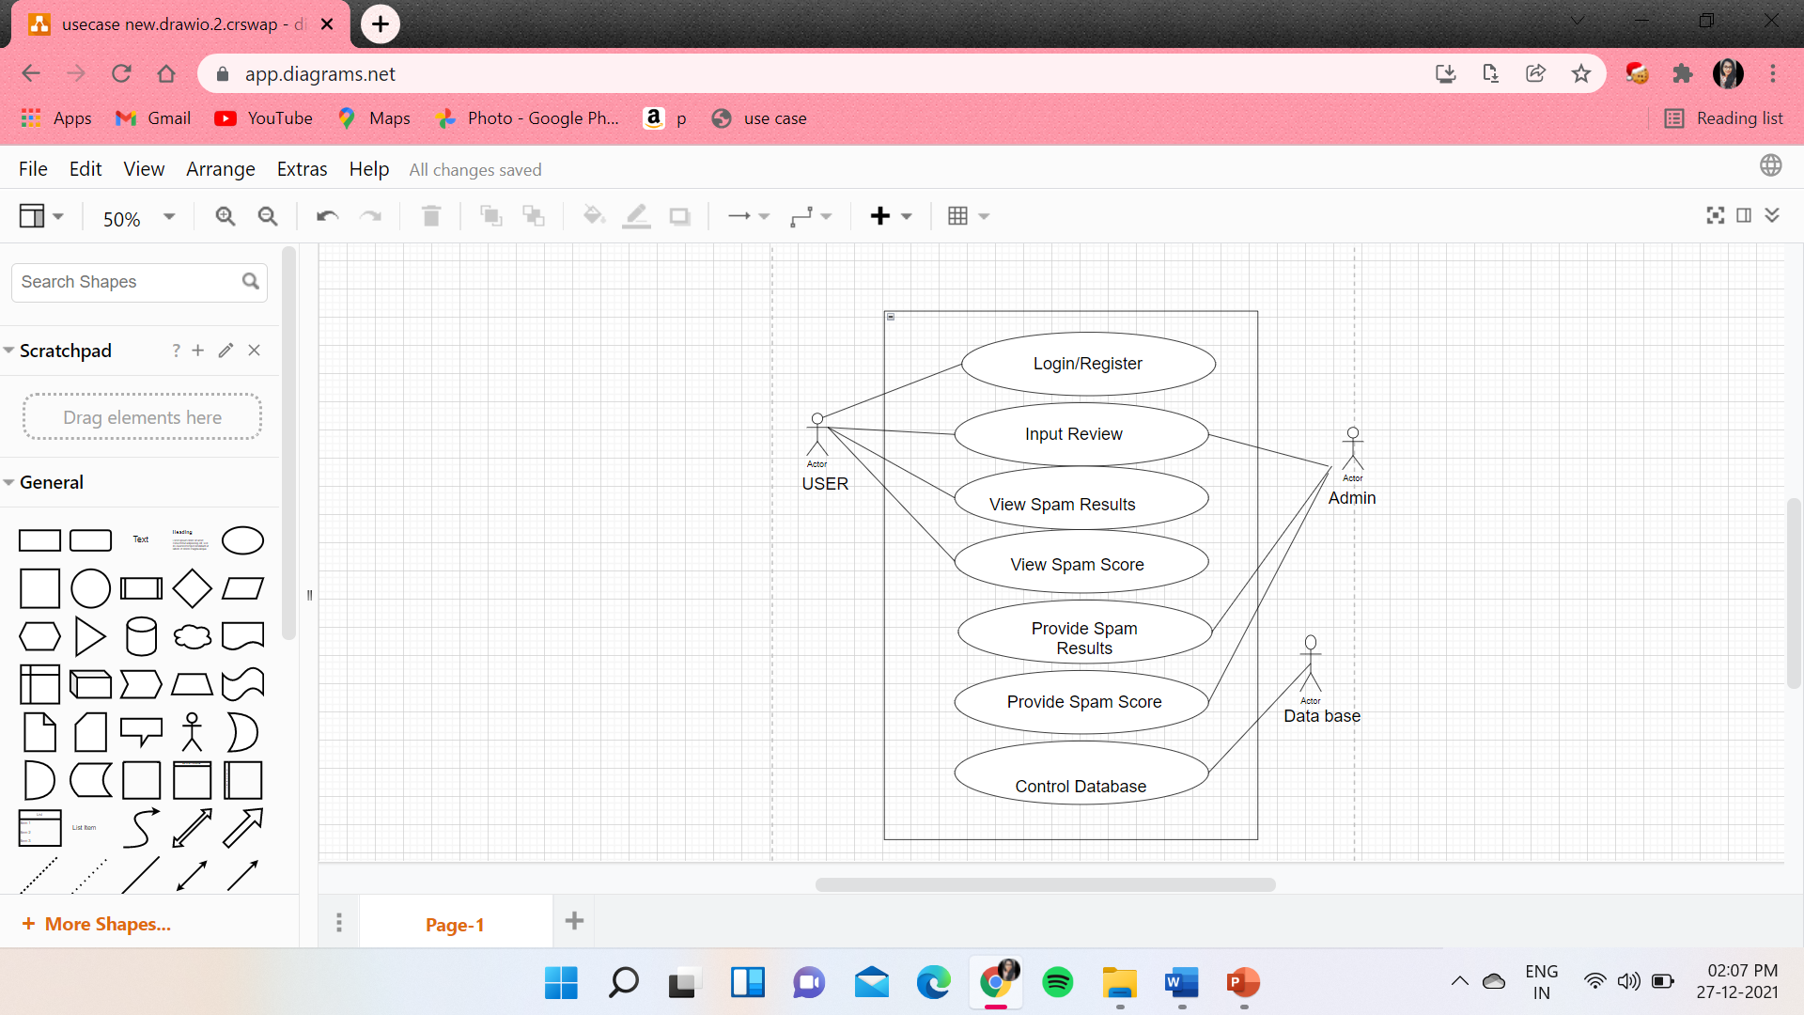
Use Case Diagram

Slide 14
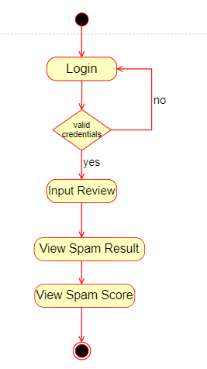
Activity Diagram

Slide 15
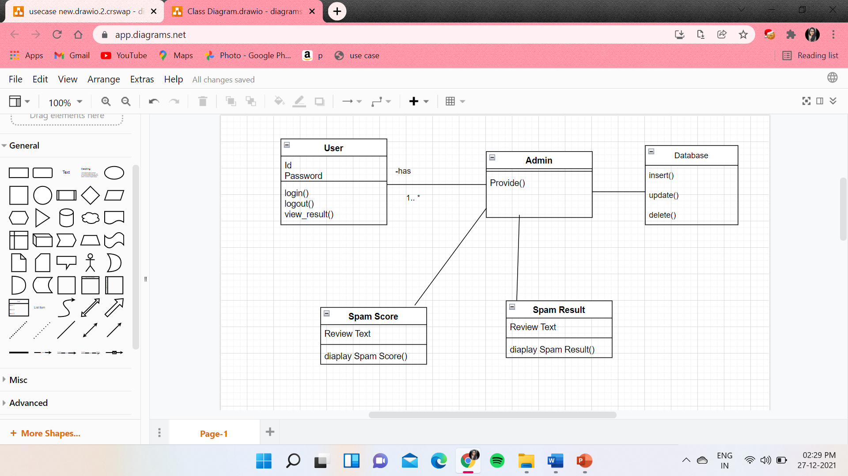
Class Diagram

Slide 16
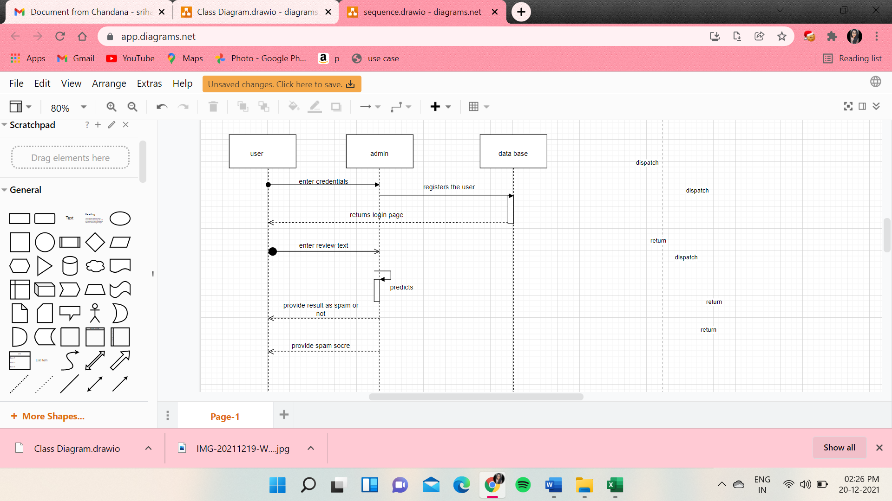
SEQUENCE DIAGRAM

Slide 17
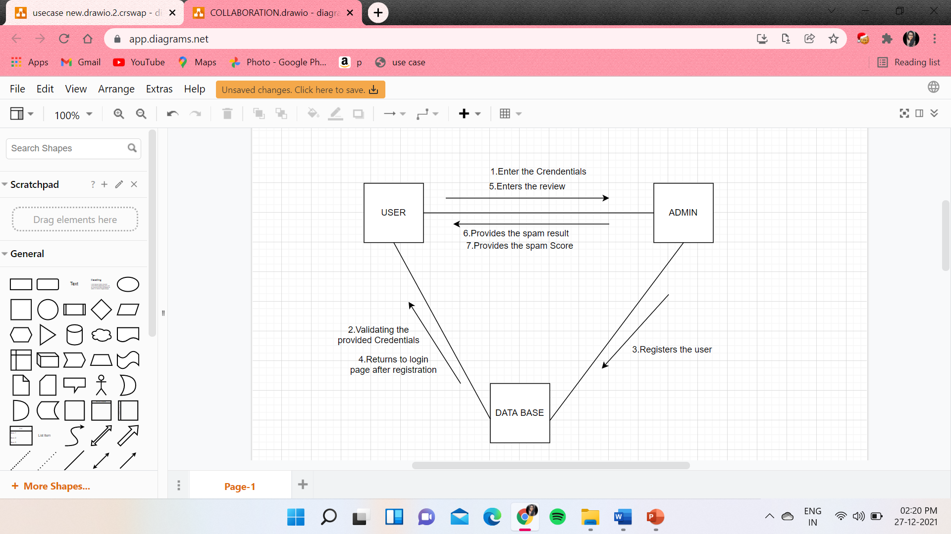
COLLABORATION DIAGRAM

Slide 18
REFERENCES
1.Spam Review Detection Using the Linguistic and Spammer Behavioral Methods
Author: Hamid Turab Mirza
2.Spam Review Detection Using Deep Learning
Author: G.M.Shahariar, Swapnil Biswas, Faiza Omar, Samiha Binte Hassan
3.https://www.fakespot.com/

Slide 19
PLAN FOR PHASE TWO :
UI Design
Import dataset
Preprocessing
Training the model
Testing the accuracy with different 4 classifiers and choosing the best

Slide 20
Thankyou☺

